Slide 1

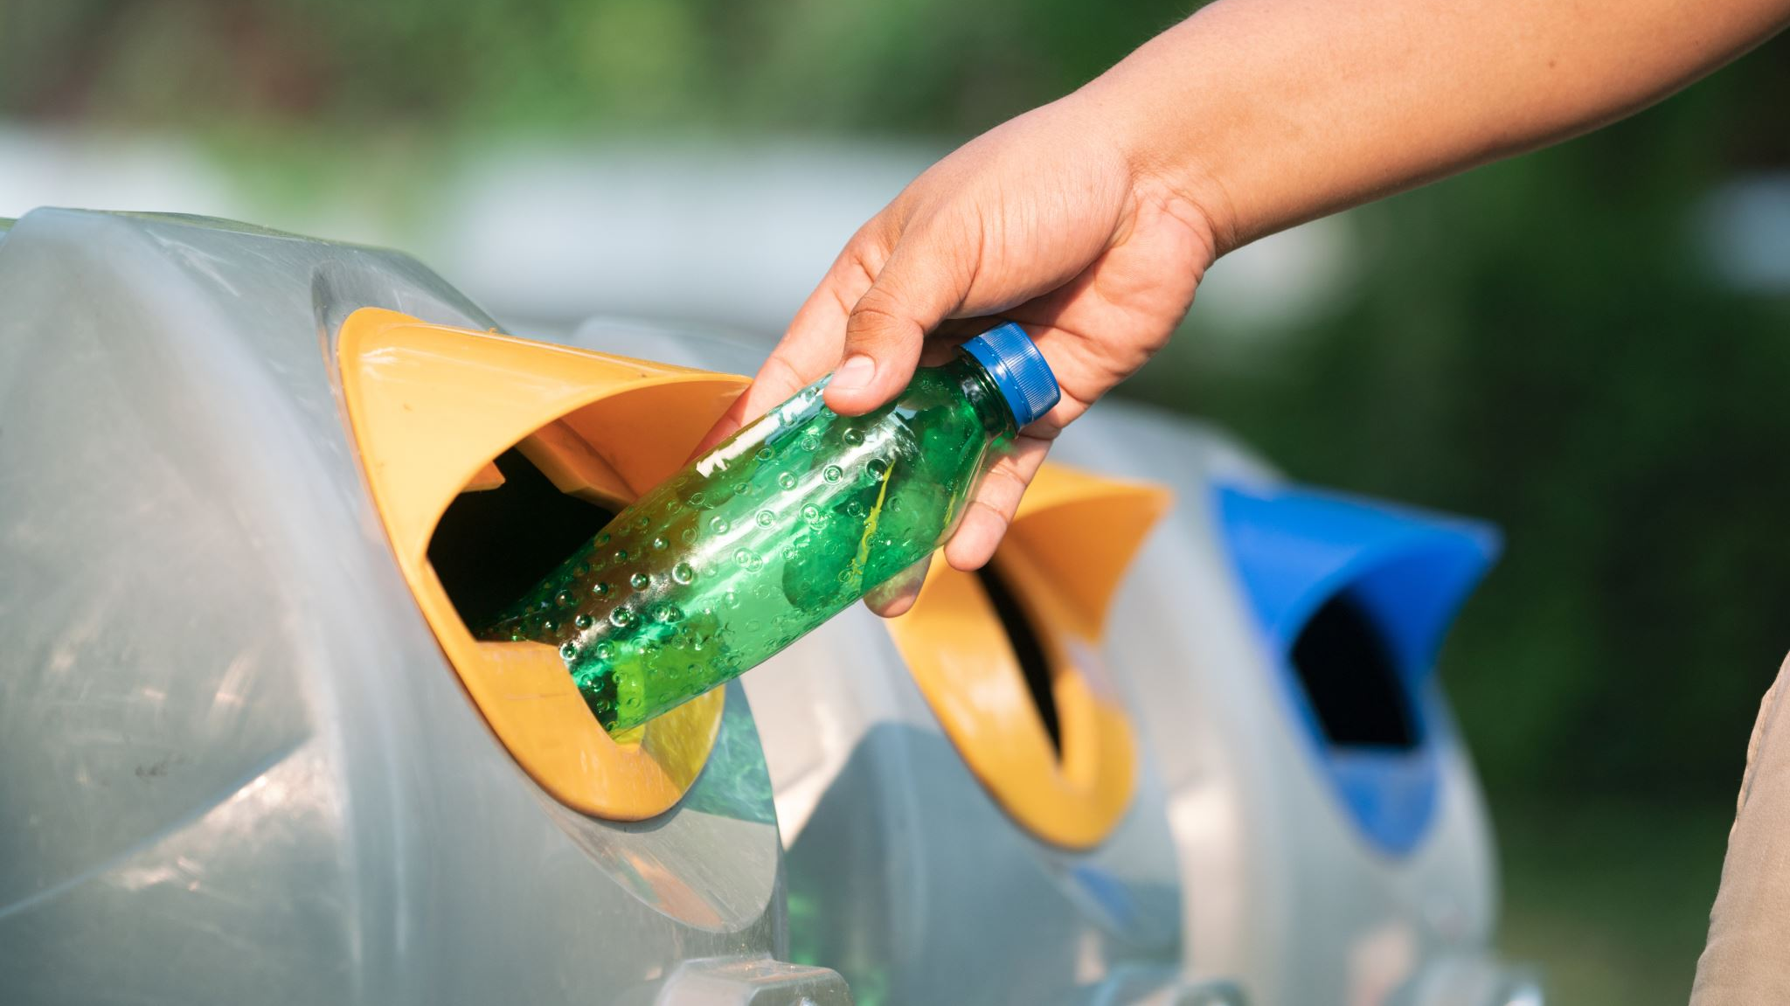
Overflowing Trash bins
Sri Navya Teja Boyapati

Slide 2

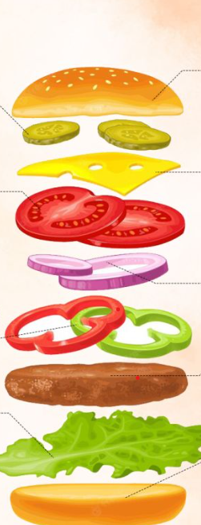
AGENDA
Introduction
Data Lifecycle
Data Generation
Data Collection
Data Processing
Data Storage
Data Management
Data Analysis
Data Visualization & Interpretation
Conclusion and Future Scope

Slide 3
AGENDA
01
Introduction
Presentations are communication tools that can be used as demonstrations.
02
Data Lifecycle
Presentations are communication tools that can be used as demonstrations.
03
Data Generation
Presentations are communication tools that can be used as demonstrations.
04
Data Collection
Presentations are communication tools that can be used as demonstrations.
05
Data Processing
Presentations are communication tools that can be used as demonstrations.

Slide 4
Overview
“Overflowing trash bins signify a challenge rooted in inadequate space for responsible waste disposal.”
Few concerns with overflowing trash bins
1.Accessibility Challenges
2..Ignorance on Disposal Practices
3.Strain on City Systems
4.Environmental consequences
Maintaining a clean and ecologically responsible community environment requires concerted efforts.
By addressing accessibility issues, promoting public awareness, enhancing community waste infrastructure, and mitigating environmental impacts, communities can navigate the complexities of waste management, fostering a healthier and more sustainable living environment for all.

Slide 5

Data Lifecycle:
As a component of the data life cycle, information was initially generated by two government entities. Subsequently, we collected and preprocessed the data using Open Refine before storing it in the Google Cloud platform. The managed data is then processed and analyzed through tools such as Big Query, Hive, and Spark.
Data Generation:
The data regarding overflowing trash bins in communities is sourced from various channels, including municipal records and reports. Information is gathered from on-site observations, community feedback, and waste management databases, providing a comprehensive understanding of the prevalence and locations of overflowing bins.

Slide 6
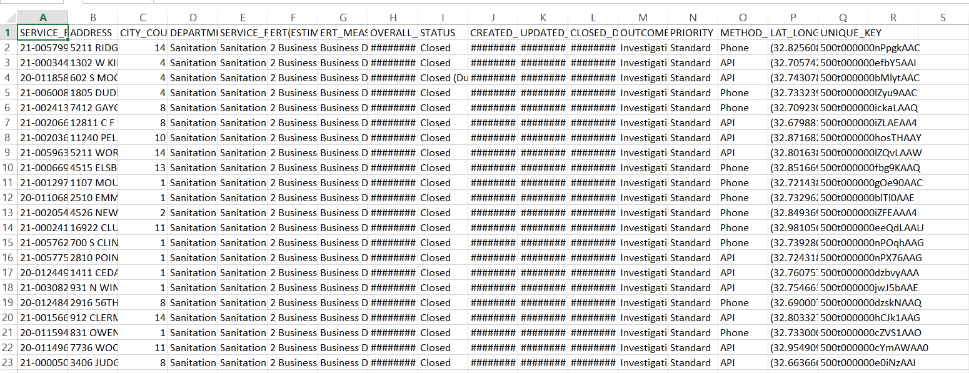
DATASET COLLECTION
The Static dataset is collected from https://www.dallasopendata.com/Services/311-Service-Requests-for-Fiscal-Year-2020-2021-Gar/tmgm-4xrh
This dataset represents all Service Requests related to garbage collection for the fiscal year time period of October 1, 2020 to September 30, 2022.

Slide 7
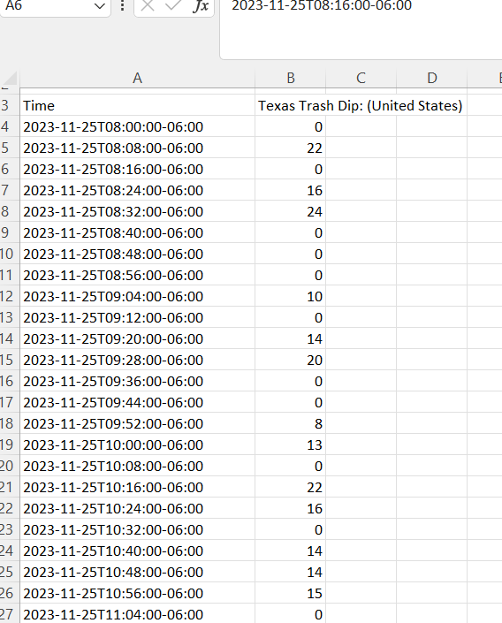
Data Collection
1.The Streaming dataset is collected from
https://trends.google.com/trends/explore?q=trash&date=now%201-d&geo=US&hl=en-US
This dataset represents Trash Forming or Trash Dipping in the Texas Area.
Each Row Represents Different Areas Trash Count.

Slide 8

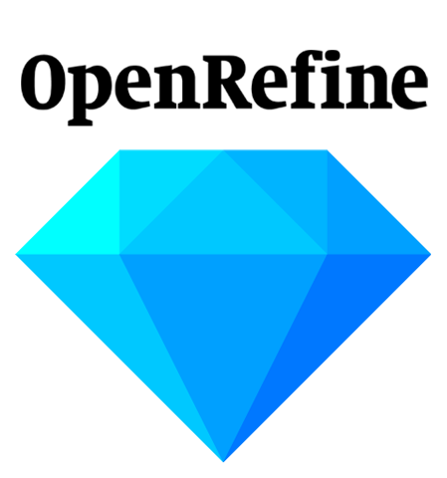
Data Preprocessing
Raw Data → →Useful Dataset
Data preprocessing is a comprehensive stage that encompasses crucial tasks such as cleaning, wrangling, compression, and encryption.
Using OpenRefine, we performed a thorough cleaning process, addressing issues like NaN values and missing data.
This comprehensive approach in employing OpenRefine ensures that our dataset is refined and ready for subsequent analysis, setting the stage for more accurate and insightful results in our exploration of the data.

Slide 9
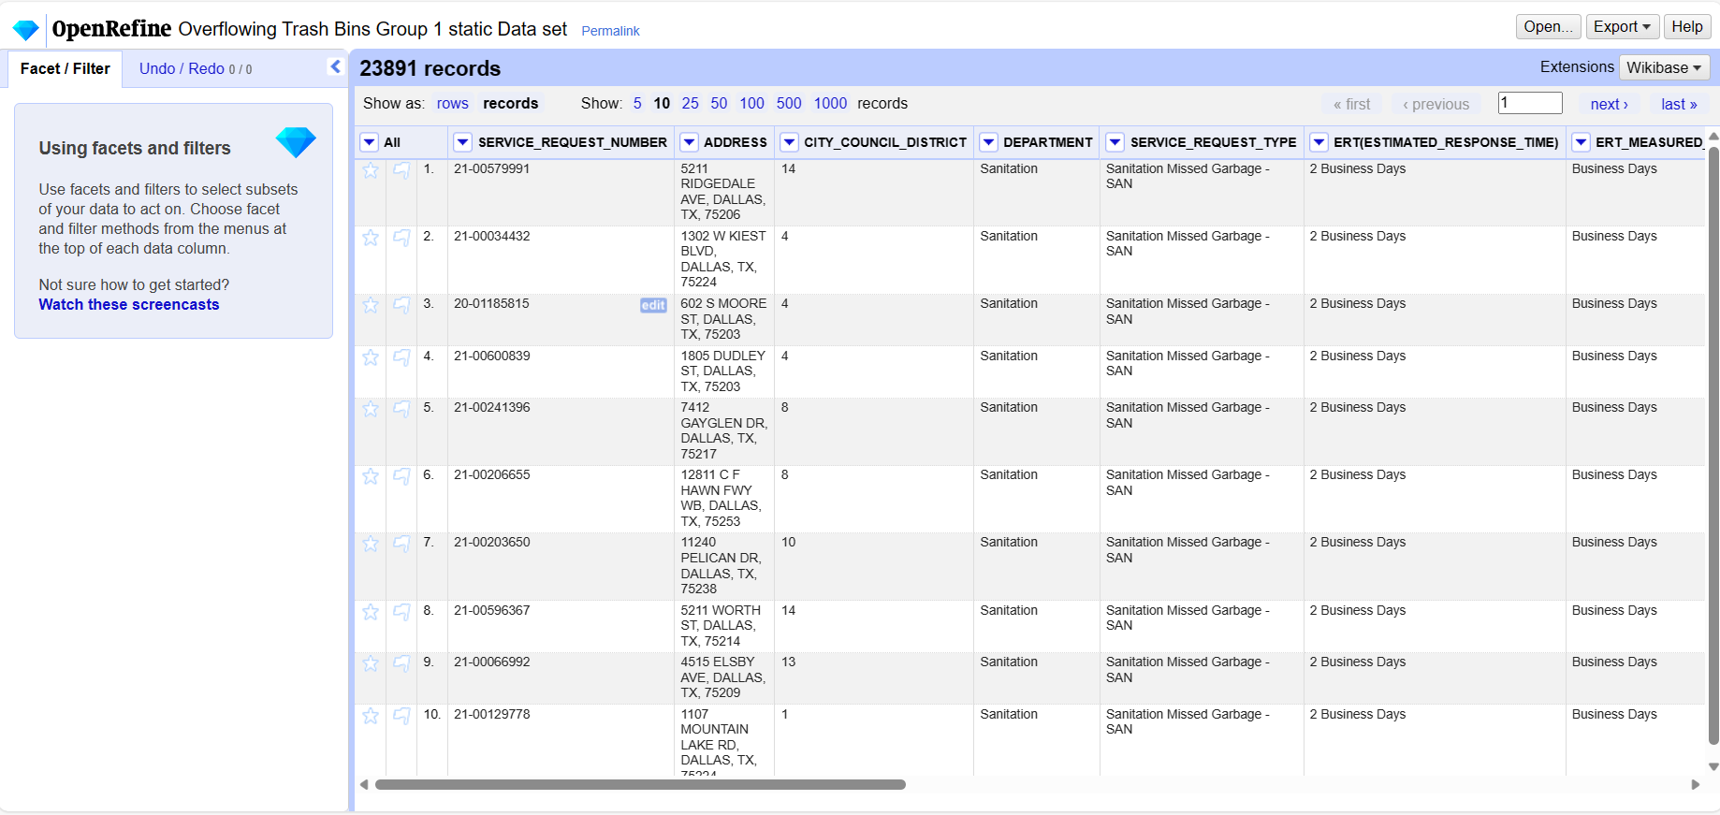
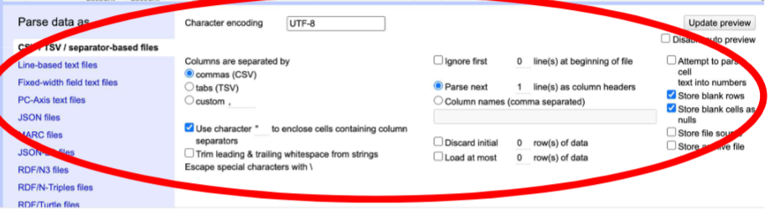

Slide 10
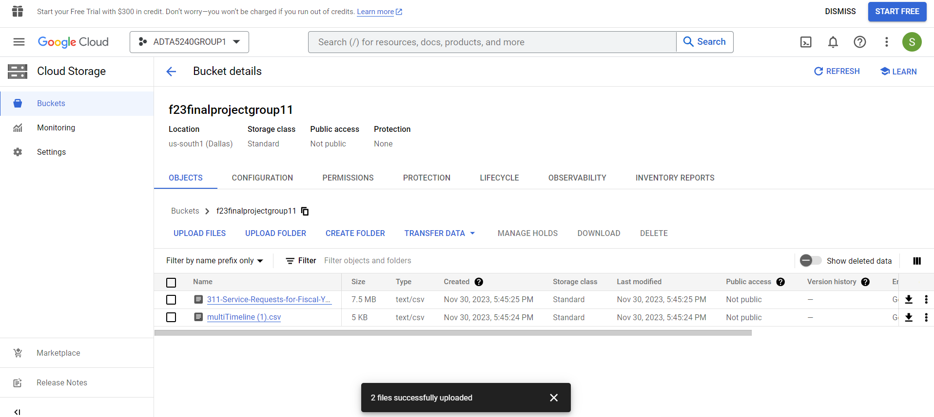
Data Storage:
Upon creating a project on Google Cloud Platform (GCP), we proceeded to store the collected data in Google Cloud Storage, employing data buckets to organize and manage the information in CSV format.
The 2 datasets that has been gathered were stored in a Storage bucket in GCP.

Slide 11
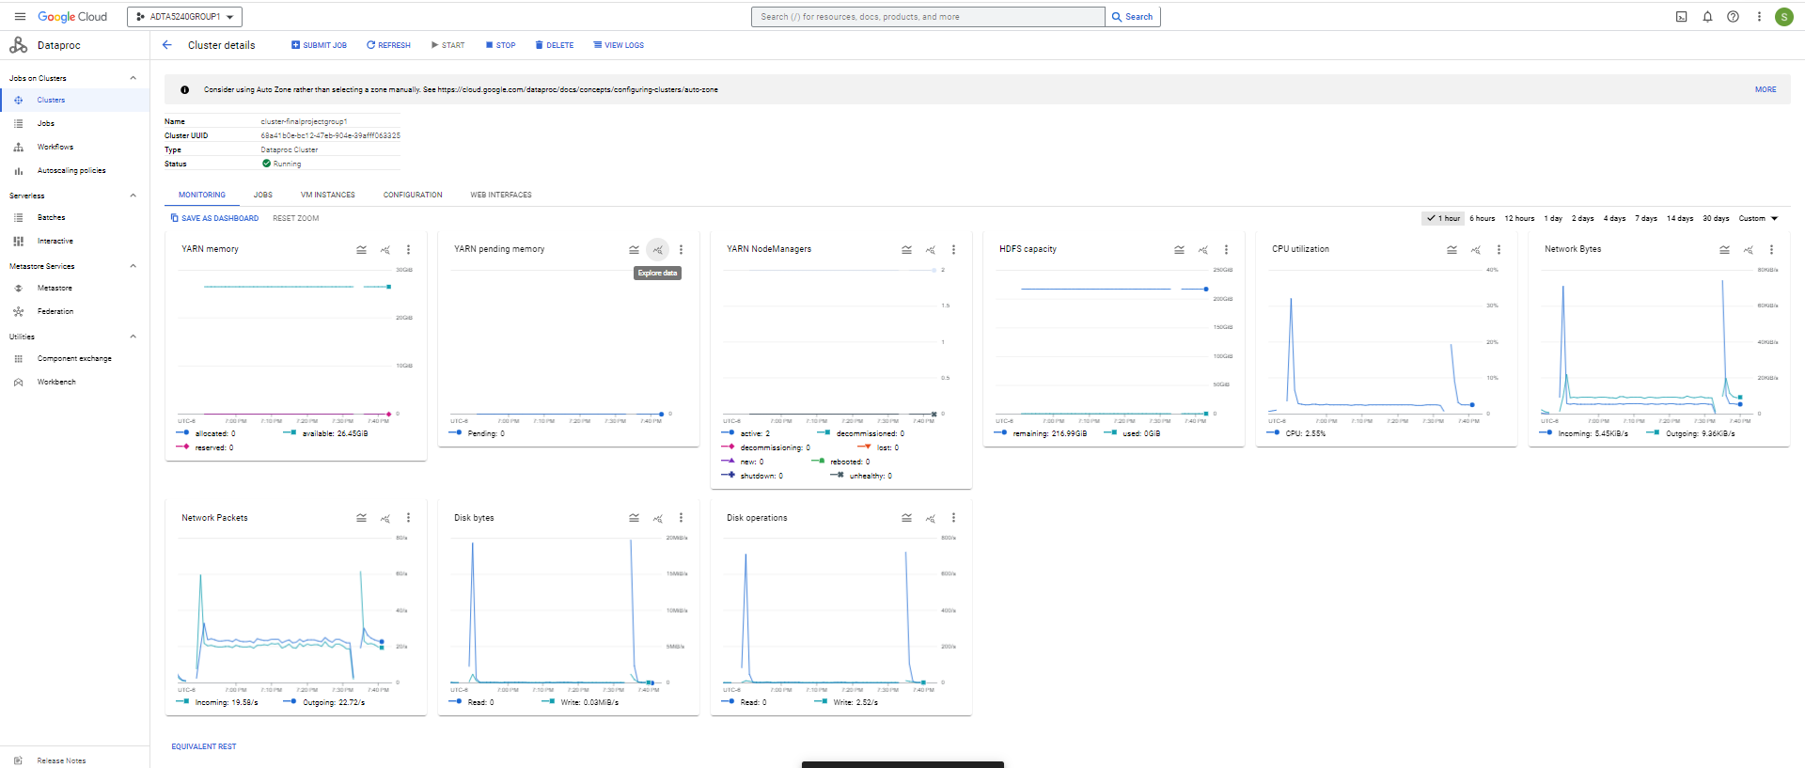
Managing Clusters

Slide 12



Data Management:
The project focused on addressing community trash bin overflow through a comprehensive data management approach, utilizing both Hadoop's core components and cloud-based tools, specifically Google Cloud.
Key components such as BigQuery, Apache Hive, and Apache Spark were employed to facilitate efficient querying, analysis, and structuring of data.
This integrated approach aimed to extract meaningful insights from the data, enabling better understanding and management of community trash bin overflow.
The combination of Hadoop's robust framework and cloud-based tools provided a scalable and effective solution for handling and deriving insights from the diverse and large-scale data associated with the project..

Slide 13
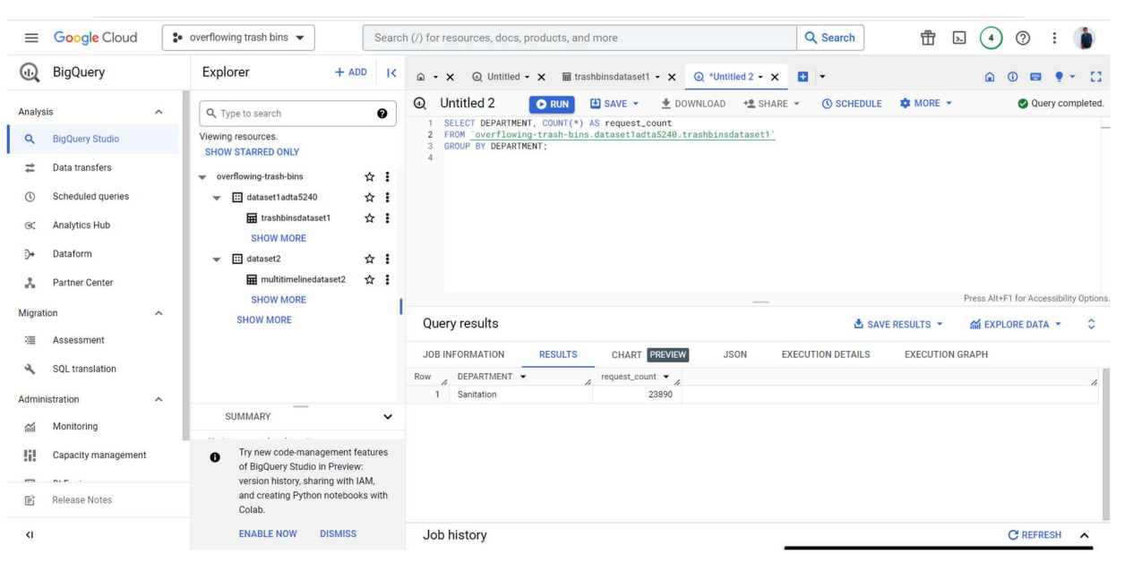
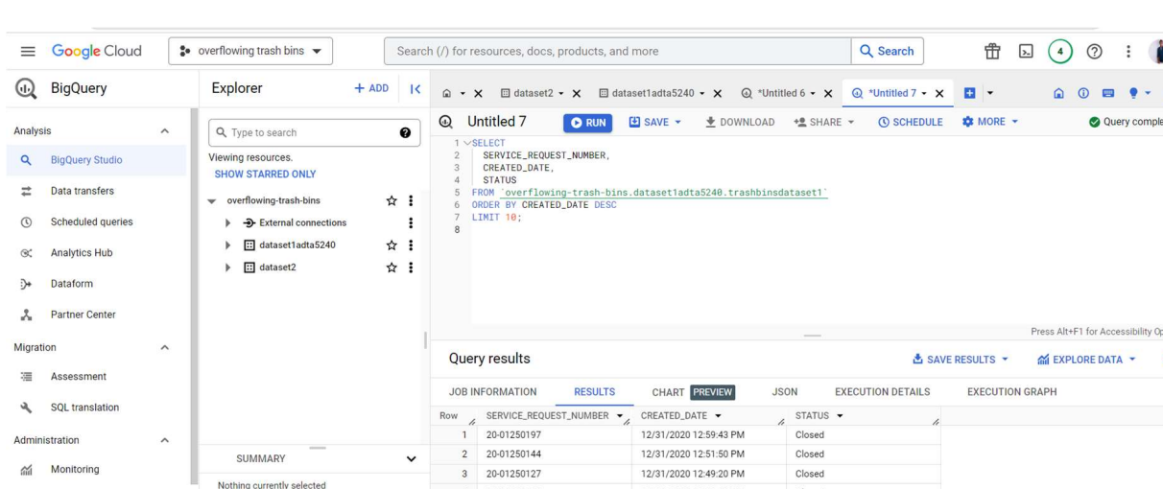
Big Query Tables:
For Streaming Dataset
For Static Dataset

Slide 14
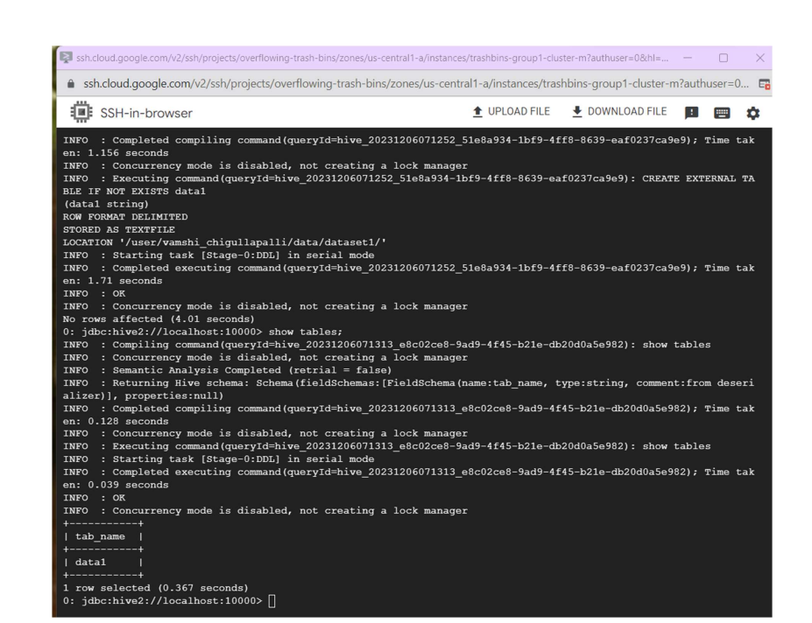
Connecting to Hive
Few of the comments before this : $ cd, $ pwd,
$ beeline –u jdbc:hive2://localhost:10000

Slide 15
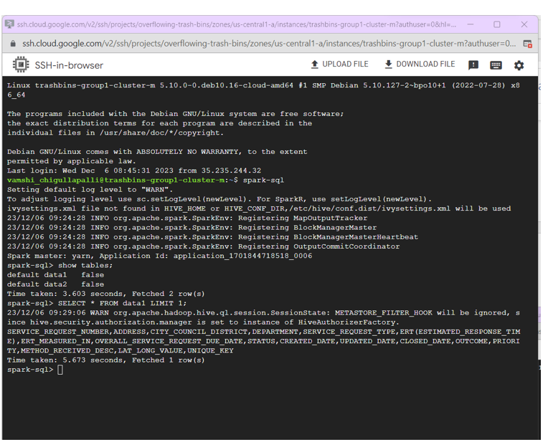
Connecting to Spark

Slide 16
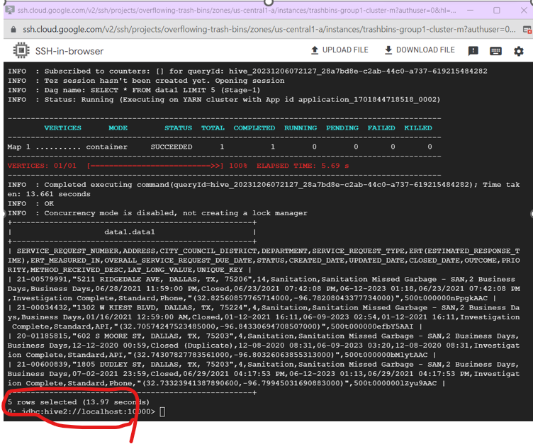
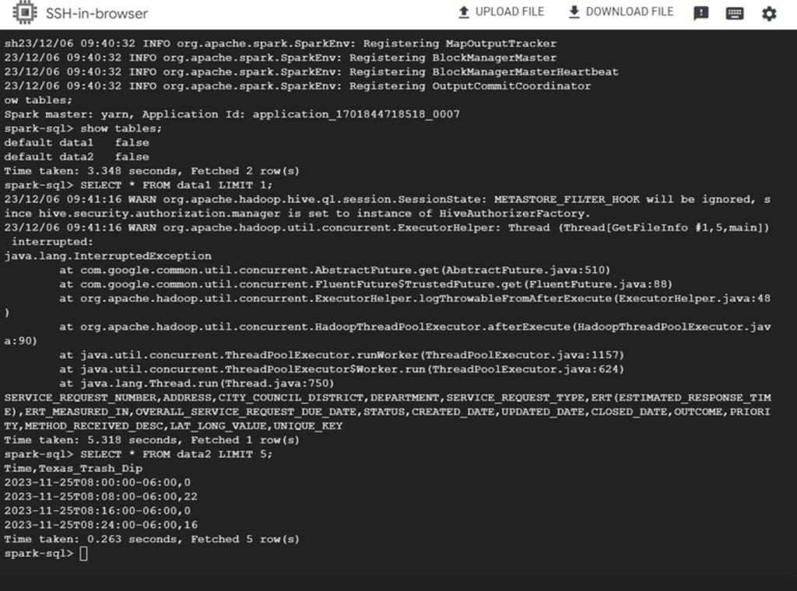

Data Analysis
Hive and Spark Comparision

Slide 17
COMparison of Apache Spark & Hive
Data Set | Query | Hive Run Time | Spark Run Time
Dataset 1 | Q1: SELECT * FROM data1 LIMIT 1 ; | 13.801 | 5.673
Dataset 1 | Q2:SELECT * FROM data 1 LIMIT 2; | 13.97 | 0.343
Dataset 2 | Q3: SELECT * FROM data2 LIMIT 5; | 14.211 | 0.263
Dataset 2 | Q4: SELECT * FROM Data 2 LIMIT 5; | 15.296 | 3.603

Slide 18
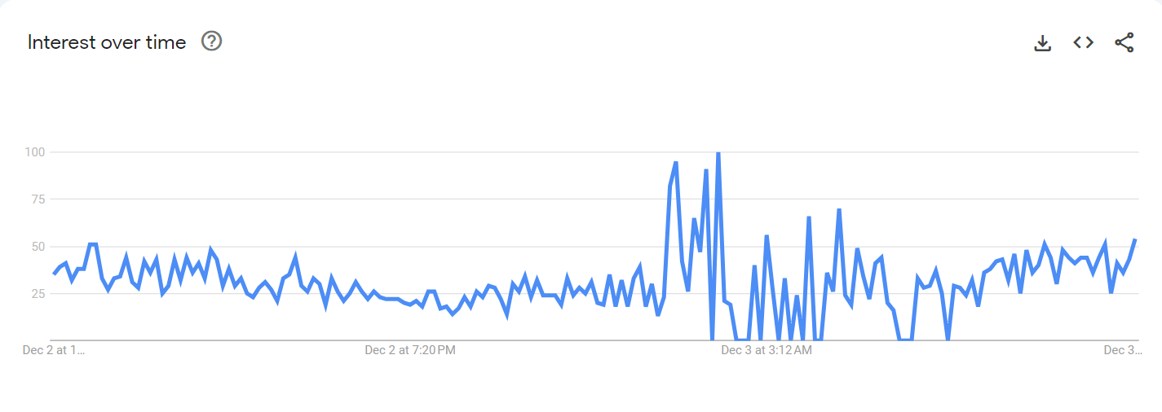
Data Visualization (Streaming Data )

Slide 19
Data Interpretation
In our efforts to address the challenge of overflowing trash bins in communities, we conducted a comprehensive data interpretation to gain insights and implement effective solutions.
Leveraging a variety of data sources, including IoT sensors, manual observations, and community reports, we obtained a diverse set of data points, allowing for a holistic understanding of the issue.
Our analysis focused on key metrics to gauge the extent of the problem:
Frequency of overflow incidents.
Times of the day or days of the week with the highest incidents.
Specific locations exhibiting frequent overflow

Slide 20
References:
https://trends.google.com/trends/explore?q=trash&date=now%201-d&geo=US&hl=en-US
https://www.dallasopendata.com/Services/311-Service-Requests-for-Fiscal-Year-2020-2021-Gar/tmgm-4xrh
https://catalog.data.gov/dataset?q=trash
https://developer.twitter.com/en/docs
https://catalog.data.gov/dataset/trash-pickup

Slide 21

Thank you

